Slide 1
Notes:
Welcome
I must send my apologies on behalf of my friend and colleague Alice Hall who cannot be here today for personal reasons.
However, im here. My name is Reuben, I’m employed by Healthscope, and I’ve been working with ACT since 2005.

Slide 2
ONLY THE DAY DAWNS
Notes:
In these 5 mins I am going to talk about 2 projects; Share You Gift and Mindful Creation.
We will also explore social media and smart phone apps in the context of mindful change

Slide 3
Notes:
Alice Hall is the founder of Share Your Gift
This started with youth work in the north Melbourne suburbs
In doing this, she was deeply moved by the prevalence and impact of youth suicide (which has caused a recent media stir)

Slide 4
Share YOUR Gift
Notes:
Share Your Gift is an organisation which encourages youth to find what makes them unique
It provides a space for youth to share their story and collaborate with others, build awareness of Youth Suicide,
and strengthens the engagement to further resources.

Slide 5
Notes:
I was invited to a Share Your Gift workshop
At this event, people expressed themselves, their ideas, through dance, poems, songs and stories about anything of their choosing.
I was deeply moved by this event and it inspired me to create something that could make a difference (share later)

Slide 6
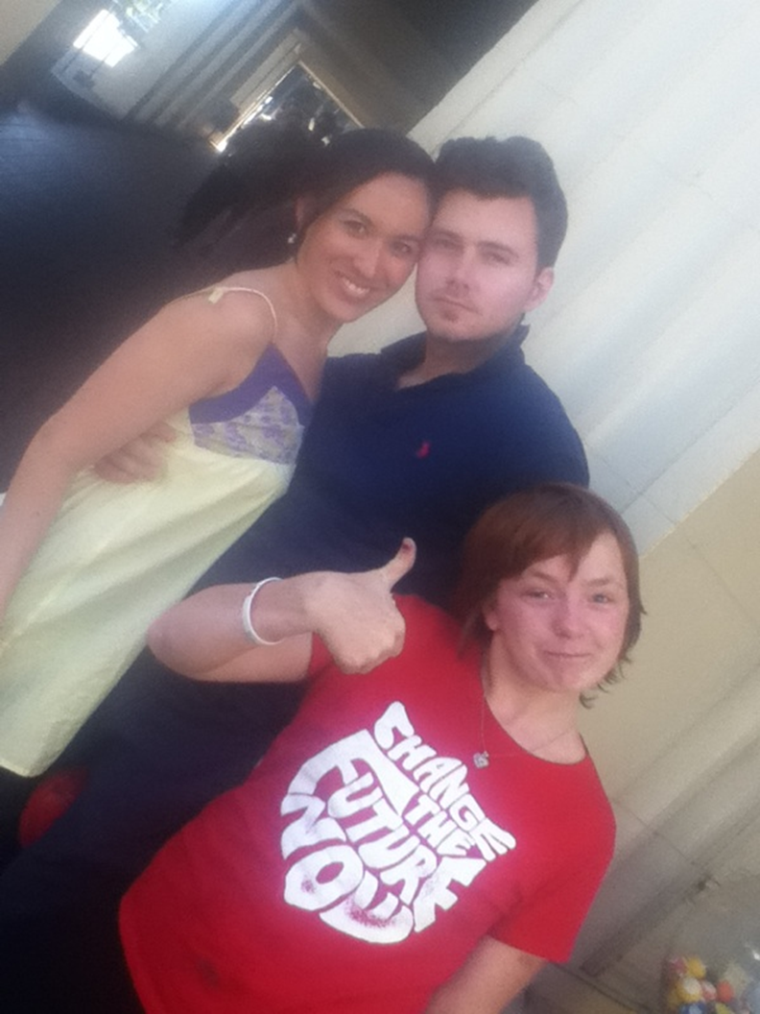
Notes:
Alice, her partner and Sky
Sky wanted to be in this presentation so I honoured her wishes!
Check out her t-shirt!

Slide 7
Notes:
My project, Mindful Creation has been set up to enhance meaningful connection.
My influences are from a range of psycho-spiritual approaches in my personal life, and a strong influence clinically from contextual psychology since 2005

Slide 8
Notes:
I want to introduce you to Heart Centred Networking, a process of reaching out to the heart and from the heart.
When we look at the core values that underpin important life areas, it all comes down to connection
This is for EVERYONE of all ages, cultures etc

Slide 9
Notes:
Heart Centred Networking – sharing, connecting, caring – pushing the title to one side, notice too a similar process to ACBS
In this context, social media is the avenue to reach out and enhance this connection

Slide 10
Notes:
There’s been recent discussions about getting ACT out to the mainstream.
In doing so, it necessary to have broad and diverse avenue to attract those that need it.
Indeed, many people are aversive to the clinical route.

Slide 11
Notes:
This is my community page on facebook
Daily posts and links regarding mindfulness and spirituality.
This provides a wide doorway to those potentially interested to further resources, including ACT.

Slide 12
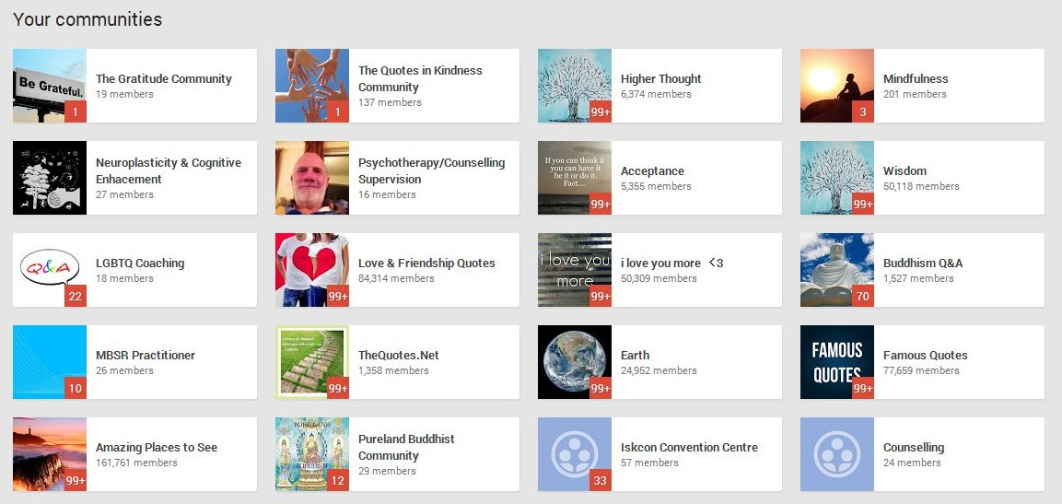
Notes:
As you will be aware there are many avenues to social media
Google+ is one such up and coming avenue which boasts a feature called circles;
And has a wide range of online communities.

Slide 13
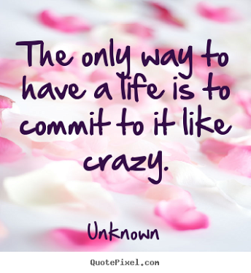
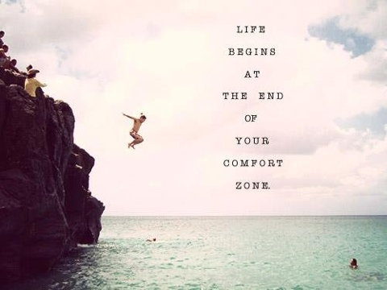
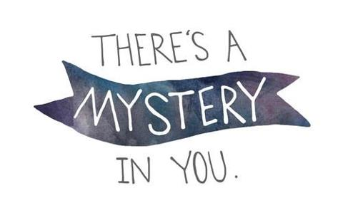
Notes:
Here are some example pictures that have indeed enticed people into this network

Slide 14
COMING SOON!
Notes:
From here people can choose from the options they have been drawn to.
Here is a template of a pending website which incorporates avenues for Heart Centred Networking, Mindfulness, ACT, Smart Phone Apps and more.

Slide 15
Notes:
An estimation by eMarketer in the UK suggests that teen smartphone users will reach 81% this year and rise to 96% in 2017.
Benefits are:
Discrete,
Convenience
and of course Apps

Slide 16
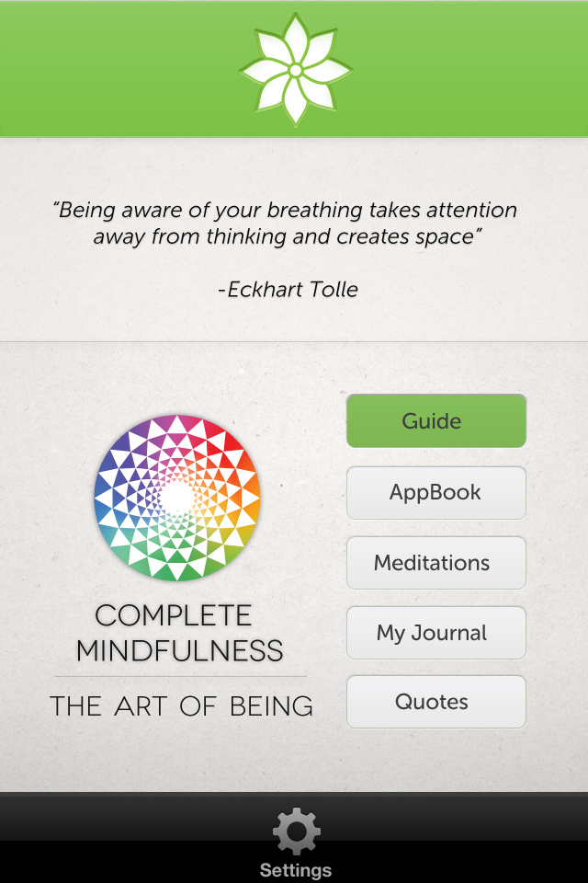
Complete Mindfulness: The Art of Being
www.mindfulinspiration.com
Notes:
Apps like this are not strictly therapy based but have the potential to reach more people.
However, this app provides a direct avenue to contextual psychology

Slide 17
Mindful Expansion: The Art of Self-Growth
info@mindfulcreation.com
Email here to receive it for FREE - Release Oct 2013
Notes:
Part of this app focuses on working with unwanted emotions, the other part, cultivating not coercing more desirable emotions;
It also has a great deal of psychoeducation that is ACT consistent.

Slide 18
2013 and beyond… Share YOUR Gift
Notes:
The aims for 2013 and beyond…
To create an anonymous survey in schools about:
Youth suicide
What resources people are aware of
What they believe will make a difference
What activities they would like in their community

Slide 19
2013 and beyond… Share YOUR Gift
Notes:
The plan is for this information to be compiled and sent to the Australian government for a funding request
Advocating the benefits of giving youth a voice, sharing and ultimately connecting

Slide 20
ACT on it: Mindfulness for Teens
This app will be FREE & available Oct 2013 on ALL smartphones
WWW.MINDFULINSPIRATION.COM
Notes:
As mentioned earlier, on being part of SYG workshop, I was inspired to create something to make a difference.
Simple, easy read basics of ACT, guided exercises and meditations, journal, quotes and more…
And it will be completely FREE.

